Slide 1
Play Store App Review Analysis
CAPSTONE PROJECT
Presented By:
SRIMAN M- JAYA ENGINEERING COLLEGE- B.E(EEE)

Slide 2
OUTLINE
Problem Statement
Proposed System/Solution
System Development Approach
Algorithm & Deployment
Result
Conclusion
Future Scope
References

Slide 3
Problem Statement
Two datasets are provided, one with basic information and the other with user reviews for the respective app.
We must examine and evaluate the data in both datasets in order to identify the important characteristics that inﬂuence app engagement and success.
So, what factors inﬂuence an app's success?
An app is said to be successful if it has:
A high average user rating
A good number of positive reviews
A good number of monthly average users
High revenue per customer and so on.

Slide 4
Proposed Solution
The purpose of our project is to gather and analyze detailed information on apps in the Google Play Store in order to provide insights on app features and the current state of the Android app market.
The Objective of the project to Explore and analyze the data to discover key factors responsible for app engagement and success.

Slide 5
System Approach
Loading the data sets: Two datasets, First Play store app
dataset and User Reviews dataset.
Import Libraries: NumPy, Pandas, Seaborn and Matplotlib
Data cleaning: Null values, Finding and removing Outliers, Removing duplicate data.
Data Imputation: Filling the missing categorical values with mode and numerical values with median. Conversion of price, installs, reviews into numerical values.
Exploratory Data Analysis: Analyzing the data sets to summarize their main characteristics using statistical graphics and data visualizations method.

Slide 6
Algorithm & Deployment
ALGORITHM
Reading the dataset and comprehending the problem statement.
Examining the business KPIs for app development and devising a solution to the problem.
Handling the error, duplicate and NaN values in the dataset.
Designing multiple visualizations to summarize the information in the dataset and successfully communicate the results and trends to the reader.

Slide 7
Algorithm & Deployment
DATA INPUT
Data Cleaning: Understand the structure of the dataset and clean data before analysis
Data Exploration: Uncover initial patterns, characteristics, and points of interest using visual exploration
Predictive Modeling: Formulate a statistical model to forecast an outcome using relevant predictors

Slide 8
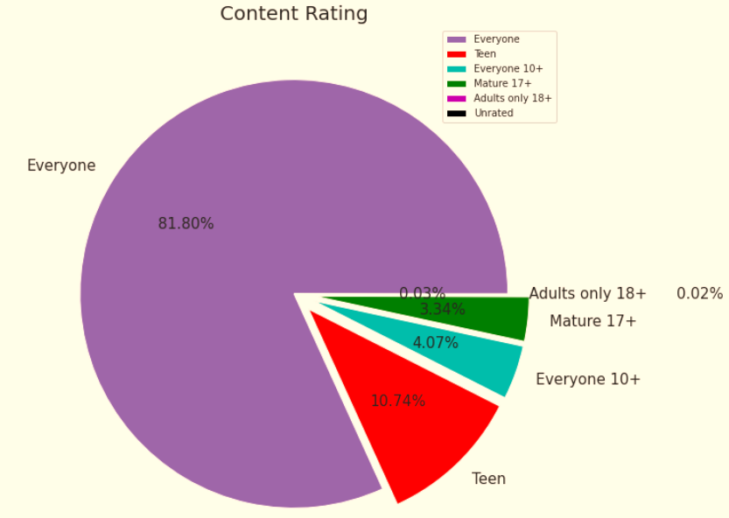
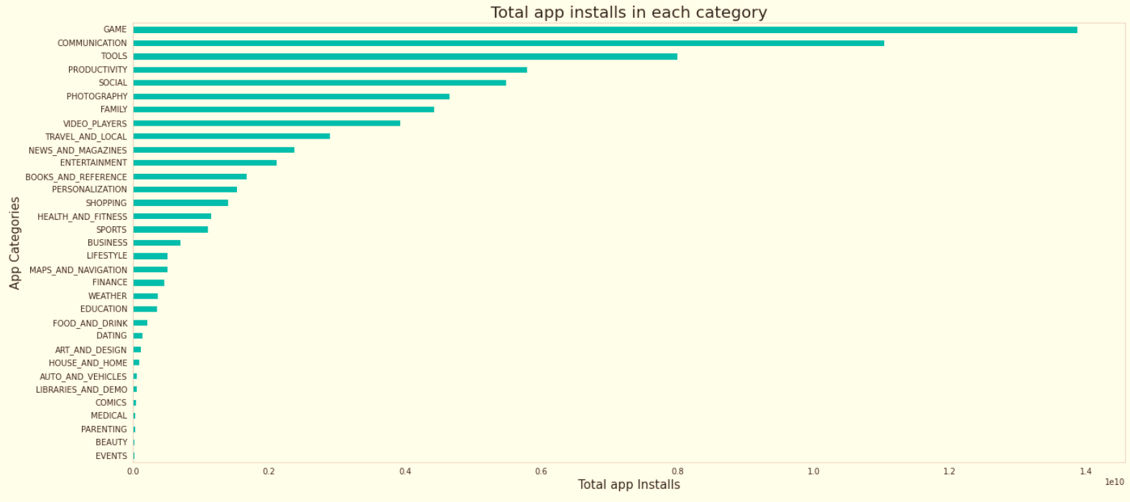
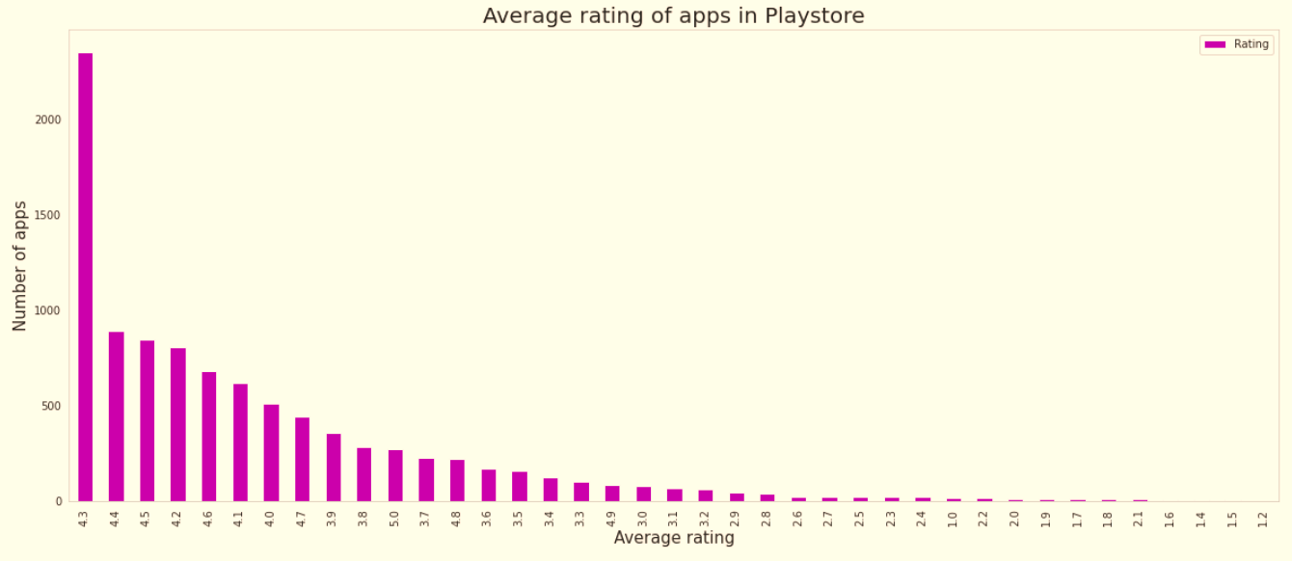
Result

Slide 9
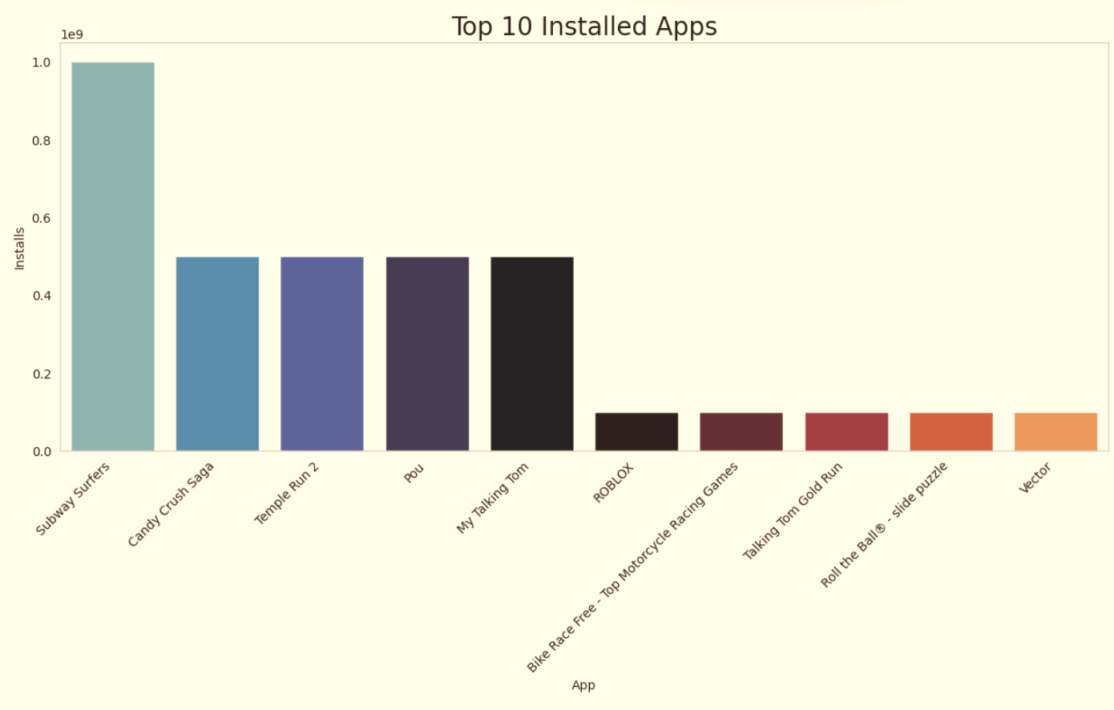
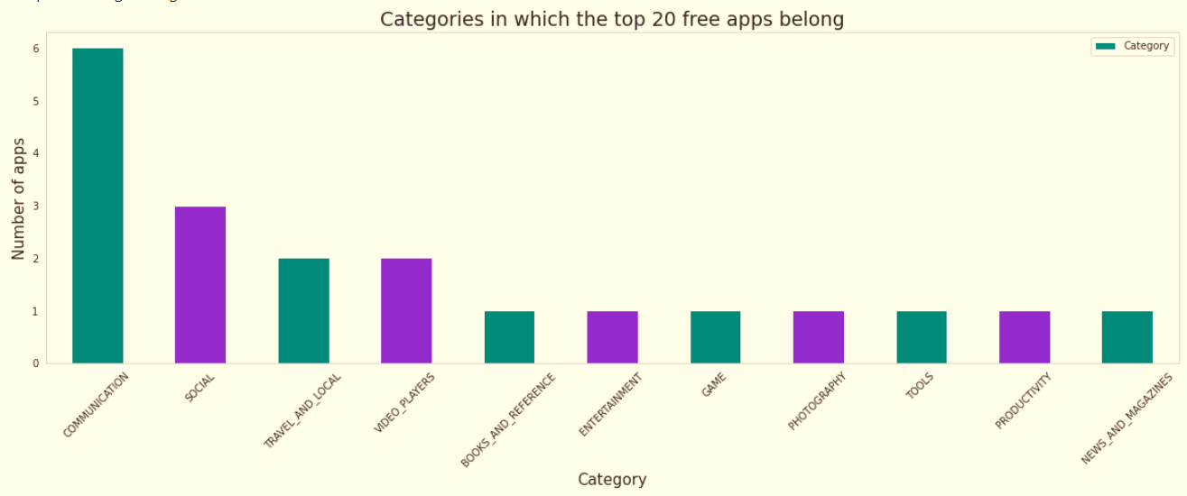
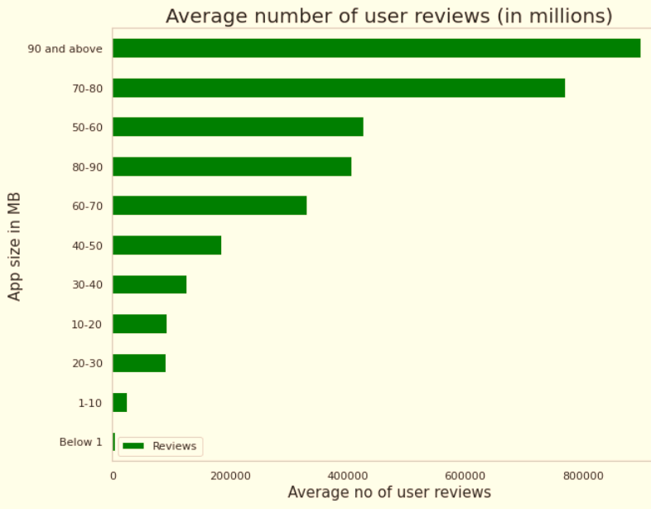
RESULT

Slide 10
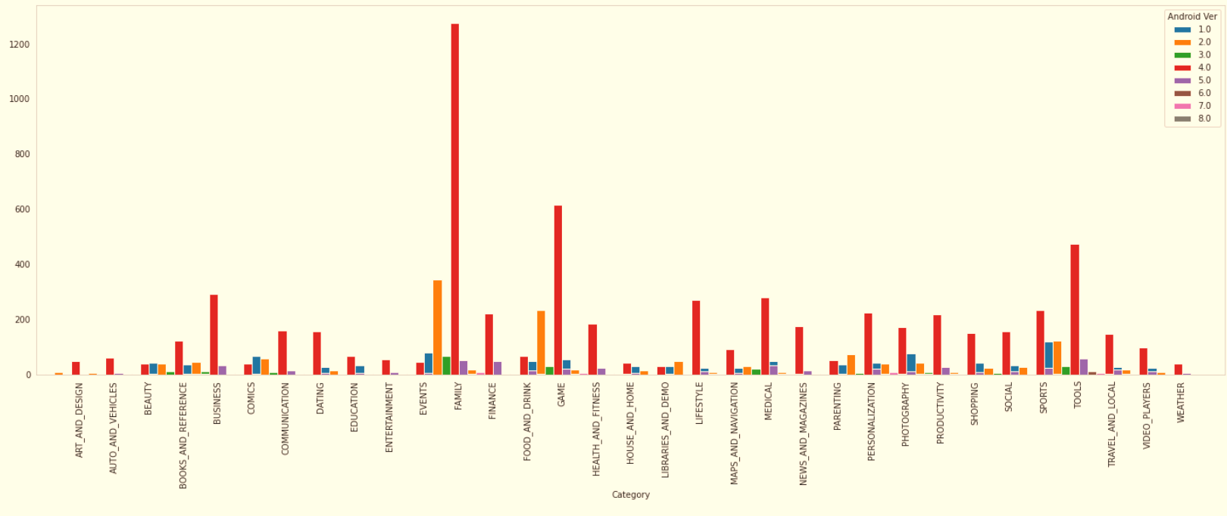
RESULT

Slide 11
Conclusion
Through exploratory data analysis we have observed some trends and have made some assumptions that might lead to app success among the users in the play store.
Percentage of free apps = ~92%
Percentage of apps with no age restrictions = ~82%
Most competitive category: Family
Family, Game and Tools are top three categories having 1906, 926 and 829 app count.

Slide 12
Future scope
In future, it is predictable that machine learning could set up ideal speculations to clarify its exhibitions.
In the meantime, its capacities of unsupervised learning will be improved since there is much information on the planet however it isn't relevant to add names to every one of them.
It is additionally anticipated that neural system structures will turn out to be increasingly unpredictable with the goal that they can separate all the more semantically important highlights.
In addition, profound learning will consolidate with support adapting better and we can utilize these points of interest to achieve more assignments.

Slide 13
References
GeeksforGeeks
Analytics Vidhya
Stackoverflow
Towards data science
Python libraries documentation
Data camp
1. Researchgate.net
2. https://www.academia.edu

Slide 14
THANK YOU

